Slide 1
Windows Internal
Slides by EaZyq

Slide 2
Overview
Processes & Thread
Memory Management
Dynamic-Link Libraries
Persistent Techniques
Payloads

Slide 3
Process & Threads

Slide 4
Process’s Question
What is a process?
What does it have?

Slide 5
Process
Definition: is a container for a set of resources used when executing the instance of the program
Contains:
A private virtual address space
An executable program
A list of open handles
A security context
A process ID
At least one thread of execution (*)
On Windows a process with no threads can be created by using NtCreateProcess from ntdll.dll
On Linux a process with 0 threads is a “zombie process”, still have an entry in the process table but is not running any code

Slide 6
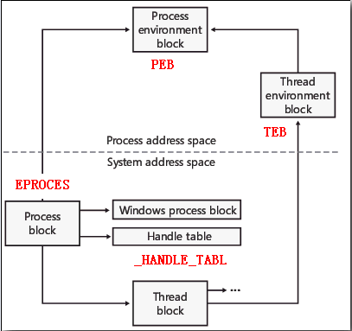
Process Internals
Each Windows process is represented by an executive process (EPROCESS) structure.

Slide 7
Process Internals
PEB:
+0x2 : UCHAR BeingDebugged
+0x10: Void* ImageBaseAddress
+0x18: struct _PEB_LDR_DATA* Ldr
TEB:
+0x60: struct _PEB* ProcessEnvironmentBlock

Slide 8
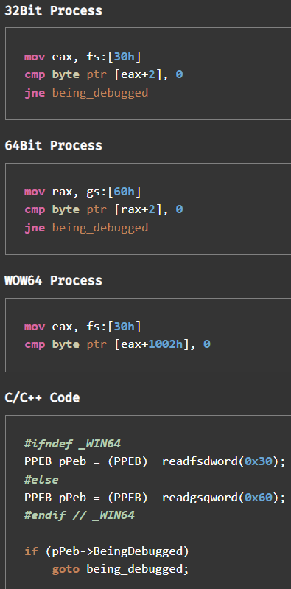
Process Internals
Using TEB to access PEB and read BeingDebugged flag

Slide 9
Flow of CreateProcess
Stage 1: Converting and validating parameters and flags
Stage 2: Opening the image to be executed
Stage 3: Creating the Windows executive process object
- Setting up the EPROCESS object
- Creating the initial process address space
- Initializing the kernel process structure
- Concluding the setup of the process address space
- Setting up the PEB
- Completing the setup of the executive process object
Stage 4: Creating the initial thread and its stack and context
Stage 5: Performing Windows subsystem-specific initialization
Stage 6: Starting execution of the initial thread
Stage 7: Performing process initialization in the context of the new process

Slide 10
Terminating a process
ExitProcess:
DLLs loaded into the process get a chance to do some work by getting notified of the process exit using a call to their DllMain function with DLL_PROCESS_DETACH
can be called only by the process itself asking to exit
TerminateProcess:
can be called from outside the process
DLLs don’t get a chance to execute code, all threads are terminated abruptly
can lead to data loss

Slide 11

Threads
Definition: A thread is a single sequential flow of control within a program.
ETHREAD contrains KTHREAD, both in the systeam address space
Thread enviroment block (TEB) in process address space (similar to PEB)
API : CreateThread / CreateRemoteThread / CreateRemoteThreadEx

Slide 12
Memory Management
Virtual Memory
Segmented and Paged memory
Address translating
Alignment
Protection Attributes
Stack & Heap

Slide 13
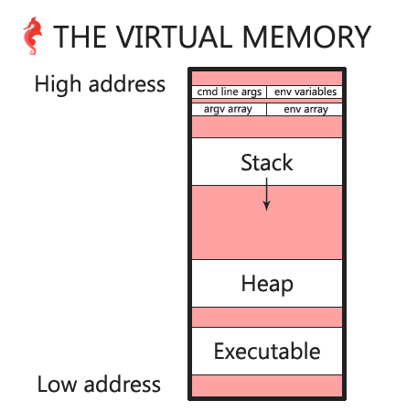
Virtual Memory

Slide 14
Virtual Memory ‘s Questions
What is virtual memory?
Why DOES OS need virtual memory?

Slide 15
Virtual Memory
Definition: is a memory management technique that provides an "idealized abstraction of the storage resources that are actually available on a given machine" which "creates the illusion to users of a very large memory“
Virtual Memory is a technique aiming to solve memory’s physical shortages by using the secondary memory so that an OS considers it as a part of the main memory

Slide 16
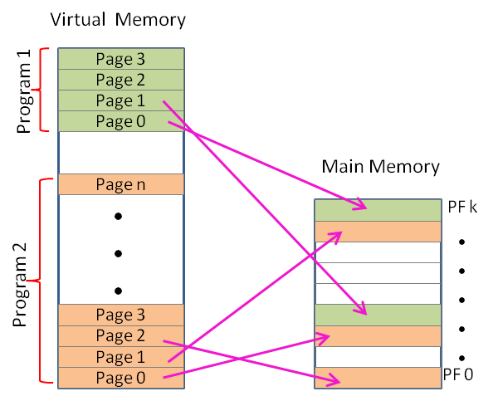

Slide 17

Virtual Memory
At run time, the memory manager-with assistance from hardware-maps the virtual address into physical address.
the memory manager has two primary tasks
+ Translating, or mapping, a process’s virtual address space into physical memory
+ Paging some of the contents of memory to disk when it becomes overcommitted
Virtual Memory: 3 What is Virtual Memory? - YouTube

Slide 18
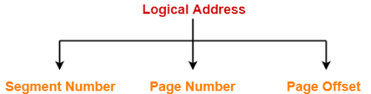
Segmented and Paged memory

Slide 19
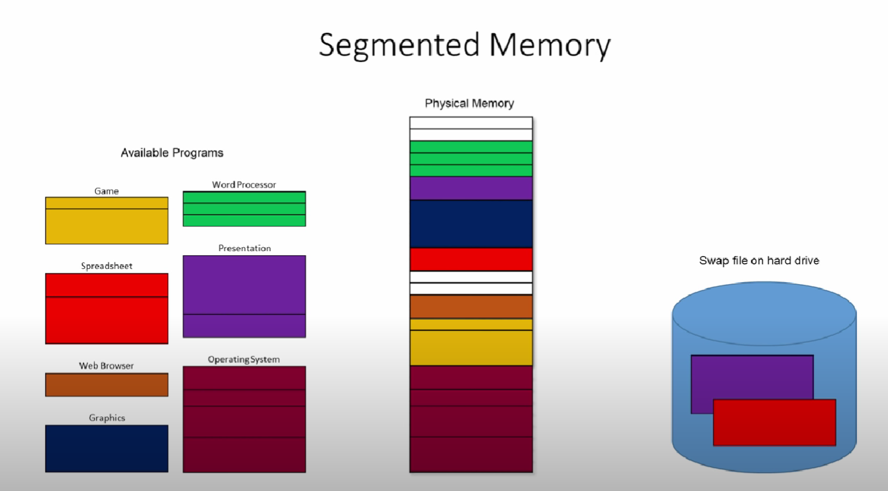
Segmentation

Slide 20
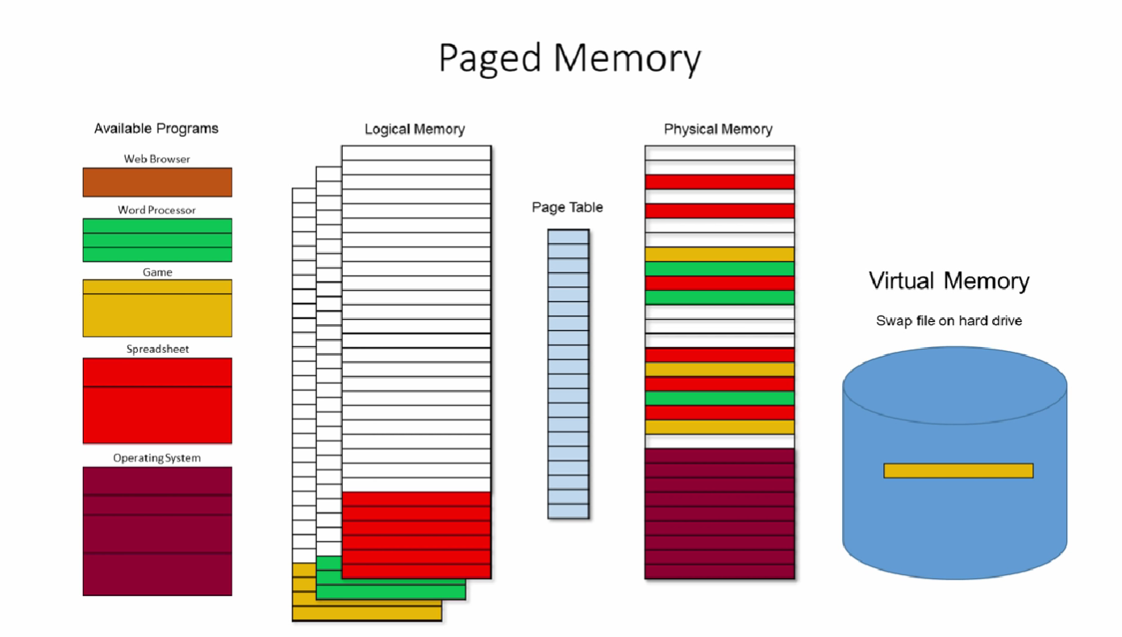

Slide 21
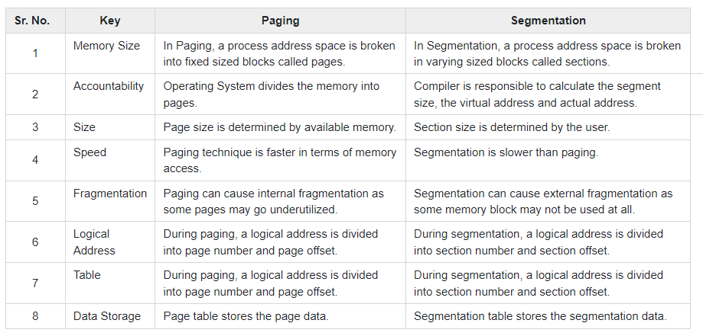
Segmented, Paged and Virtual Memory - YouTube

Slide 22
Address translating
From a virtual memory address to physical address:
- Dissect the virtual address into a virtual page number and offset
- The page offset is passed through as it is not translated
- The virtual page number is looked up in the TLB, looking for a tag with the corresponding number
- There is an entry in the TLB (hit) , meaning we immediately can translate the virtual to the physical address
- If there is no entry in the TLB, TLB reaches out to memory (MMU) to find page number
Virtual Memory: 7 Address Translation Example Walkthrough - YouTube

Slide 23
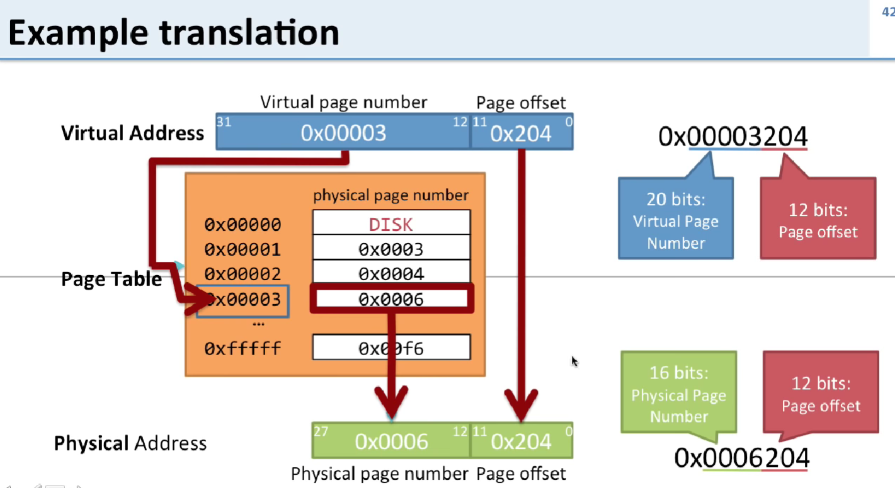

Slide 24

Alignment
The CPU always reads at its word size (4 bytes on a 32-bit processor)
Alignment is required for faster data reading

Slide 25
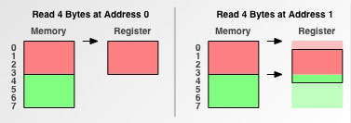

Slide 26
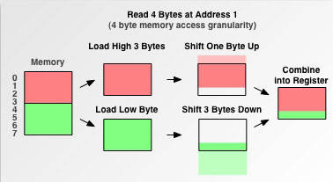
Data alignment: Straighten up and fly right - IBM Developer

Slide 27
Protection Attributes
Windows applies protection attributes for each page
It prevents a process from accessing memory that has not been allocated to it, prevents a bug or malware within a process from affecting other processes, or the operating system itself

Slide 28
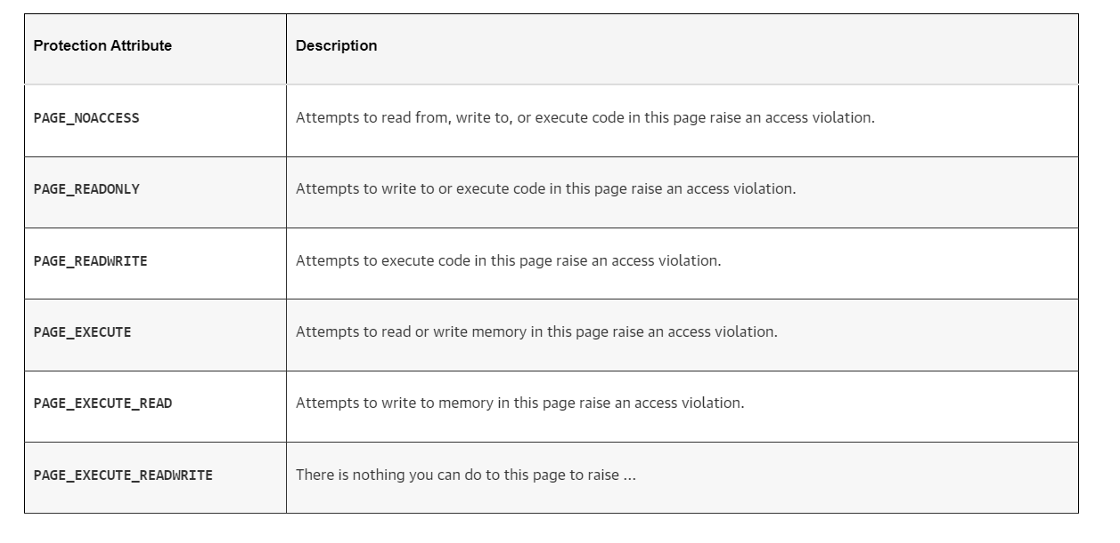

Slide 29
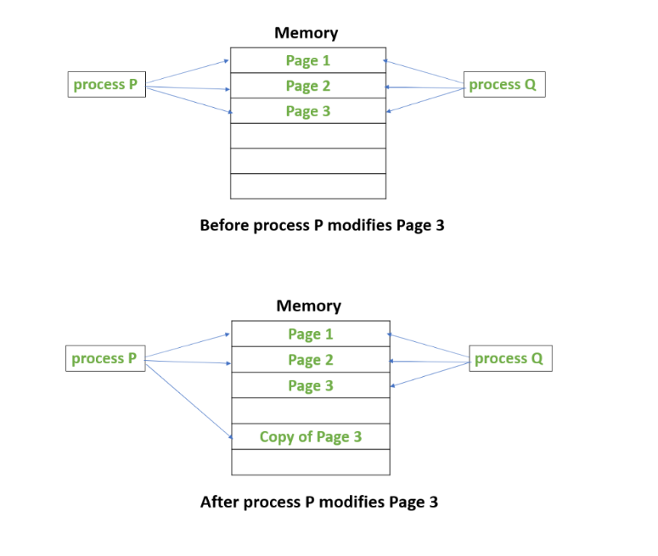
Copy-on-Write
Copy on Write - GeeksforGeeks

Slide 30
Stack & Heap

Slide 31
Stack
When a thread is created, the memory manager automatically reserves 1MB for user stack and 12KB (32-bit) for kernel stack
Stores local data, return addresses, used for parameter passing
Variables created on the stack will go out of scope and are automatically deallocated.

Slide 32
Heap
Stored in computer RAM just like the stack
Used on demand to allocate a block of data for use by the program
Can have allocation failures if too big of a buffer is requested to be allocated
Responsible for memory leaks

Slide 33
Dynamic-Link Libraries

Slide 34
DLL ‘s questions
What is a DLL?
Why using DLL?

Slide 35
DLL
Definition: A DLL is simply a set of source code modules, with each module containing a set of functions that an application (executable file) or another DLL will call
Reasons to use:
+ Extend the features of an application
+ Simplify project management
+ Help conserve memory
+ Facilitate resource sharing
+ Facilitate localization
+ Resolve platform differences
+ Serve special purpose

Slide 36
DLL
Before an application (or another DLL) can call functions in a DLL, the DLL's file image must be mapped into the calling process' address space
Once a DLL's file image is mapped into the calling process' address space, the DLL's functions are available to all the threads running within the process and loses all of its identity as a DLL
There is a table of exported symbols contains the list of exported variables, functions, and class symbols and the relative virtual address (RVA) indicating where each symbol can be found in the DLL module.

Slide 37
When an executable file is invoked
1. The operating system loader creates the virtual address space for the process
2. The loader maps the executable module into the process' address space
3. The loader examines the executable's import section and attempts to locate and map any required DLLs into the process' address space
4. After all the DLL modules have been located and mapped into the process' address space, the loader fixes up all references to imported symbol. To do this, it again looks in each module's import section. For each symbol listed, the loader examines the designated DLL's export section to see if the symbol exist

Slide 38
DLL search order
The directory containing the executable image file
The Windows system directory returned by GetWindowsDirectory
The 16-bit system directory—that is, the System subfolder under the Windows directory
The Windows directory returned by GetSystemDirectory
The process' current directory
The directories listed in the PATH environment variable

Slide 39
Avoidance
Should avoid calls to LoadLibrary(Ex) and FreeLibrary from inside DllMain because these functions can create dependency loop
Avoid create/kill thread and process in DllMain, that activity can cause deadlock (details: windows via c-c++ pages 548)

Slide 40

DLL INJECTION AND API HOOKING

Slide 41
Using the registry
Set HKEY_LOCAL_MACHINE\Software\Microsoft\Windows NT\CurrentVersion\Windows\AppInit_Dlls key with the value of the dll
Set LoadAppInit_Dlls to 1
When the User32.dll library is mapped into a new process, it receives a DLL_PROCESS_ATTACH notification
Then User32.dll retrieves the saved value of this key and calls LoadLibrary for each DLL specified in the string with an dwReason value of DLL_PROCESS_ATTACH
Disadvantages:
+ Doesn't work for most CUI-based application
+ DLL is mapped into EVERY GUI-based application makes the greater change of crashing the "container" processes
+ Only works if the app is started
Event Triggered Execution: AppInit DLLs, Sub-technique T1546.010 - Enterprise | MITRE ATT&CK®

Slide 42
Using Windows hooks
SetWindowsHookEx() : when a window is about to process a message, the system will map a Dll and call a specific function
UnhookWindowsHookEx() : When a thread calls the UnhookWindowsHookEx function, the system cycles through its internal list of processes into which it had to inject the DLL and decrements the DLL's lock count

Slide 43
Using remote threads
Because we can't easily control the threads in a process other than our own, this solution requires that we create a new thread in the target process by using CreateRemoteThread()
We must bypassing the thunk and must get the exact memory location of LoadLibraryW by calling GetProcAddress first
Step details: (windows via c/c++ page 600)

Slide 44
Persistent Techniques
Modifying registry keys
Special folders
Task scheduler
DLL search order hijacking
Shortcut hijacking
WMI event subscription

Slide 45

Modifying registry keys
Adversaries may achieve persistence by adding a program to a startup folder or referencing it with a Registry run key
Adding an entry to the "run keys" in the Registry or startup folder will cause the program referenced to be executed when a user logs in
These programs will be executed under the context of the user and will have the account's associated permissions level

Slide 46
Modifying registry keys
HKEY_CURRENT_USER\Software\Microsoft\Windows\CurrentVersion\Run
HKEY_CURRENT_USER\Software\Microsoft\Windows\CurrentVersion\RunOnce
HKEY_LOCAL_MACHINE\Software\Microsoft\Windows\CurrentVersion\Run
HKEY_LOCAL_MACHINE\Software\Microsoft\Windows\CurrentVersion\RunOnce
Boot or Logon Autostart Execution: Registry Run Keys / Startup Folder, Sub-technique T1547.001 - Enterprise | MITRE ATT&CK®

Slide 47
Special folders
There is a startup folder location for individual user accounts as well as a system-wide startup folder that will be checked regardless of which user account logs in
The startup folder path for the current user is C:\Users\[Username]\AppData\Roaming\Microsoft\Windows\Start Menu\Programs\Startup
The startup folder path for the current user is C:\Users\[Username]\AppData\Roaming\Microsoft\Windows\Start Menu\Programs\Startup

Slide 48
Task scheduler
An adversary may use Windows Task Scheduler to execute programs at system startup or on a scheduled basis for persistence.

Slide 49
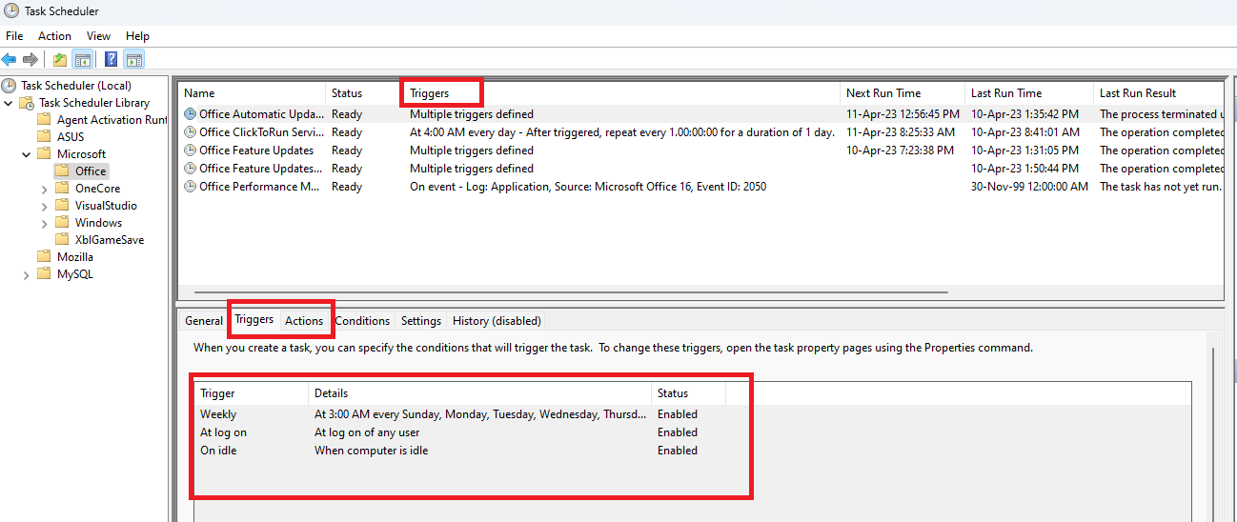

Slide 50
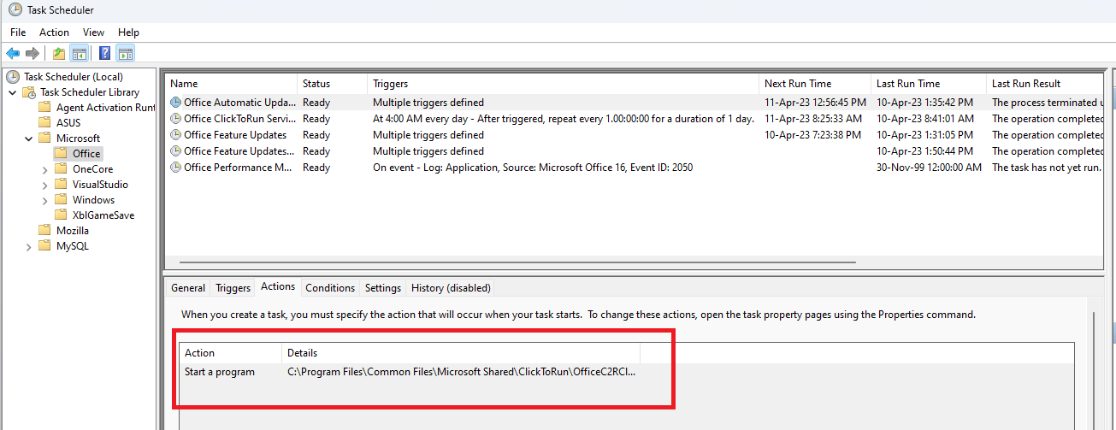
Scheduled Task/Job: Scheduled Task, Sub-technique T1053.005 - Enterprise | MITRE ATT&CK®

Slide 51
DLL search order hijacking
The directory containing the executable image file
The Windows system directory returned by GetWindowsDirectory
The 16-bit system directory—that is, the System subfolder under the Windows directory
The Windows directory returned by GetSystemDirectory
The process' current directory
The directories listed in the PATH environment variable

Slide 52
Shortcut hijacking
Adversaries may create or modify shortcuts that can execute a program during system boot or user login.
Shortcuts or symbolic links are used to reference other files or programs that will be opened or executed when the shortcut is clicked or executed by a system startup process.
Boot or Logon Autostart Execution: Shortcut Modification, Sub-technique T1547.009 - Enterprise | MITRE ATT&CK®
Persistence – Shortcut Modification – Penetration Testing Lab (pentestlab.blog)

Slide 53
WMI event subscription
Adversaries may establish persistence and elevate privileges by executing malicious content triggered by a Windows Management Instrumentation (WMI) event subscription.
WMI can be used to install event filters, providers, consumers, and bindings that execute code when a defined event occurs
Event Triggered Execution: Windows Management Instrumentation Event Subscription, Sub-technique T1546.003 - Enterprise | MITRE ATT&CK®
Persistence – Shortcut Modification – Penetration Testing Lab (pentestlab.blog)

Slide 54

Payloads

Slide 55
Keylogger
Adversaries may log user keystrokes to intercept credentials as the user types them.
Keylogging is likely to be used to acquire credentials for new access opportunities when OS Credential Dumping efforts are not effective, and may require an adversary to intercept keystrokes on a system for a substantial period of time before credentials can be successfully captured.
Input Capture: Keylogging, Sub-technique T1056.001 - Enterprise | MITRE ATT&CK®

Slide 56
Credential API Hooking
Hooks procedures, which intercept and execute designated code in response to events such as messages, keystrokes, and mouse inputs
Import address table (IAT) hooking, which use modifications to a process’s IAT, where pointers to imported API functions are stored
Inline hooking, which overwrites the first bytes in an API function to redirect code flow

Slide 57
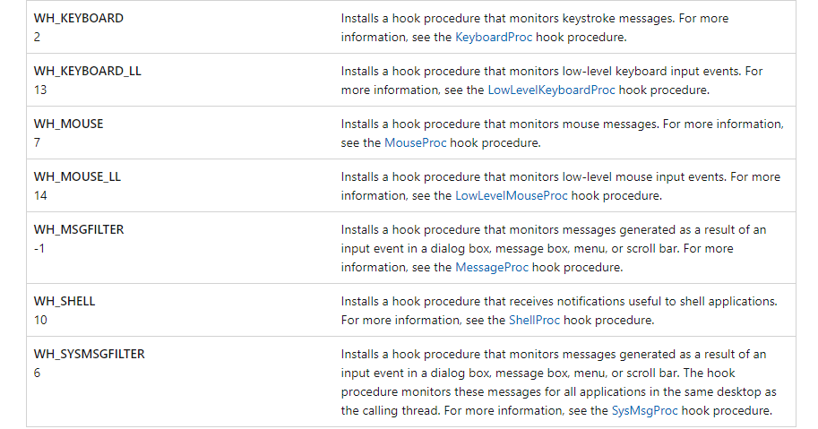
SetWindowsHookEX
Installs an application-defined hook procedure into a hook chain.

Slide 58
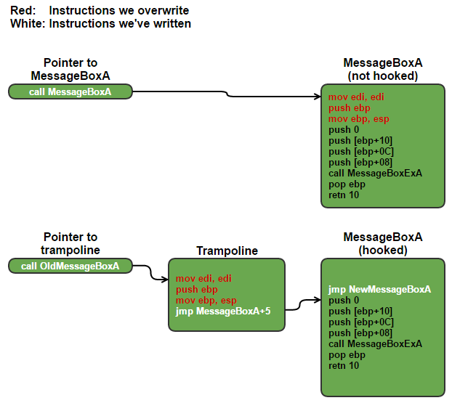
Inline Hooking
Modify function’s prologue to redirect the control flow
Inline Hooking for Programmers (Part 1: Introduction) (malwaretech.com)

Slide 59
RAT
Remote Access Trojans are programs that provide the capability to allow covert surveillance or the ability to gain unauthorized access to a victim PC

Slide 60
RAT
Because RAT provides administrative control, the attacker can do almost anything on the victim’s computer, for example:
- Monitor user behavior via spyware or keyloggers
- Access sensitive details, including social security numbers and credit card
- Activate a system’s recording video and webcam
- Take screenshots
- Distribute malware and viruses
- Format drives
- Download, alter, or delete files and file systems

Slide 61
Credentical Dumping
LSASS Memory OS Credential Dumping: LSASS Memory, Sub-technique T1003.001 - Enterprise | MITRE ATT&CK®
Windows Credential Manager Credentials from Password Stores: Windows Credential Manager, Sub-technique T1555.004 - Enterprise | MITRE ATT&CK®
Credentials from Web Browsers Credentials from Password Stores: Credentials from Web Browsers, Sub-technique T1555.003 - Enterprise | MITRE ATT&CK®

Slide 62

THE END

